Slide 1

Smart System
Supervision Dr .Lila Abou Hashem
Paper published in 2021

Slide 2
What we can do with project

Slide 3
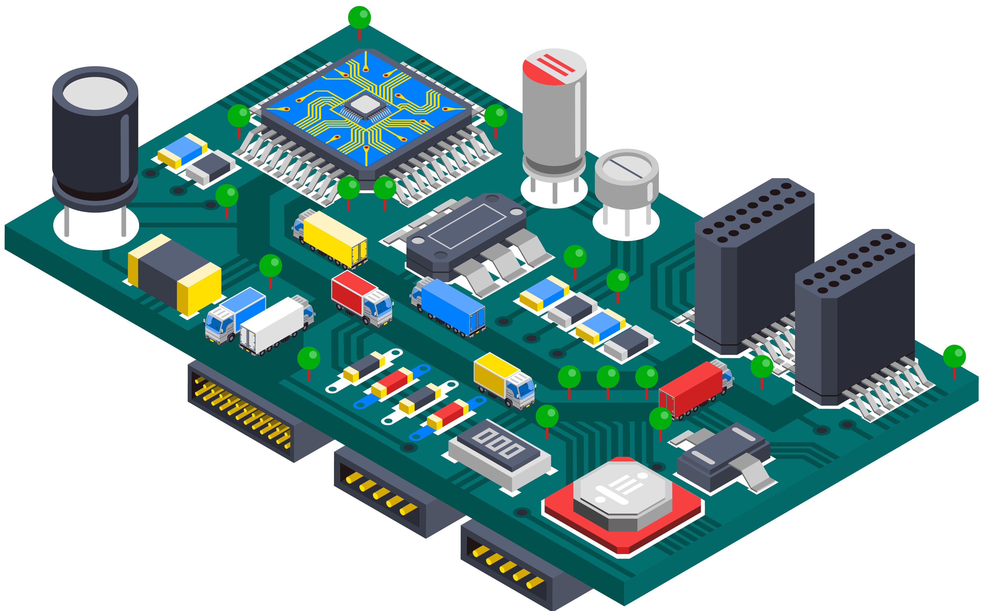
What we can do with project
Bluetooth
control
module is used which acts as a medium and helps the data gets transmitted
home appliance remotely using a smart phone
Measure
electricity bill
values of voltage and current which will be further used in the generation of bill
in a way of reducing the human effort in calculating all the necessary parameters
Arduino UNO
Smart
The values from the sensors are communicated to the Arduino UNO
making houses smarter where one can control the appliance remotely

Slide 4
Using Mobile Phone app(Blynk)
03
04
portable devices are used as a User Interface
03
04
compatible even with a meter
02
02
05
05
get the data from the Bluetooth
commands with the help of AI such as Google Assistant, Siri, Alexa etc.
01
01
06
06
Android Application
disabled ones to control household appliance and may help in reducing the electricity consumption in a household

Slide 5
Main components of that simulaion

Slide 6
01
ARDUINO UNO SIMULINO UNO ATMEGA328P
Simulation in Proteus
02
COMPIM COM Port Physical Interface model
03
LED Animated LED model (Yellow)
04
FAN

Slide 7
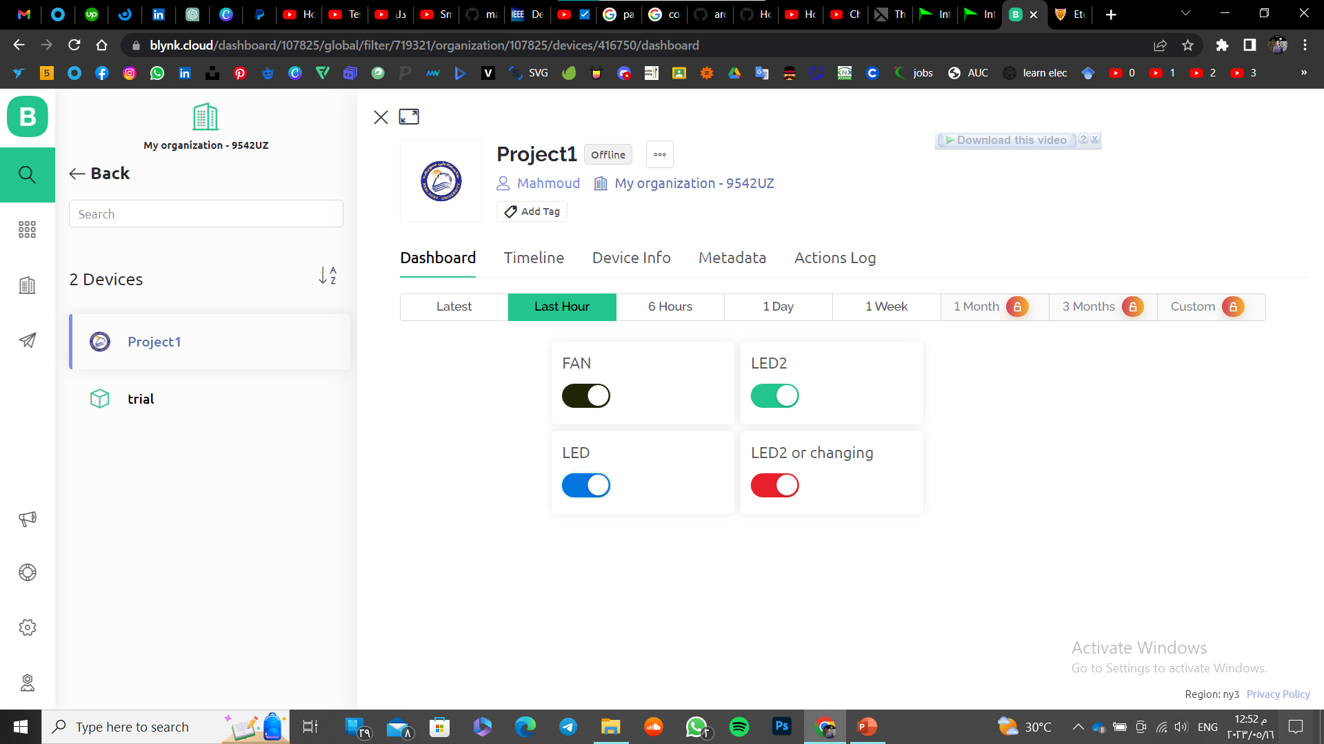

Slide 8
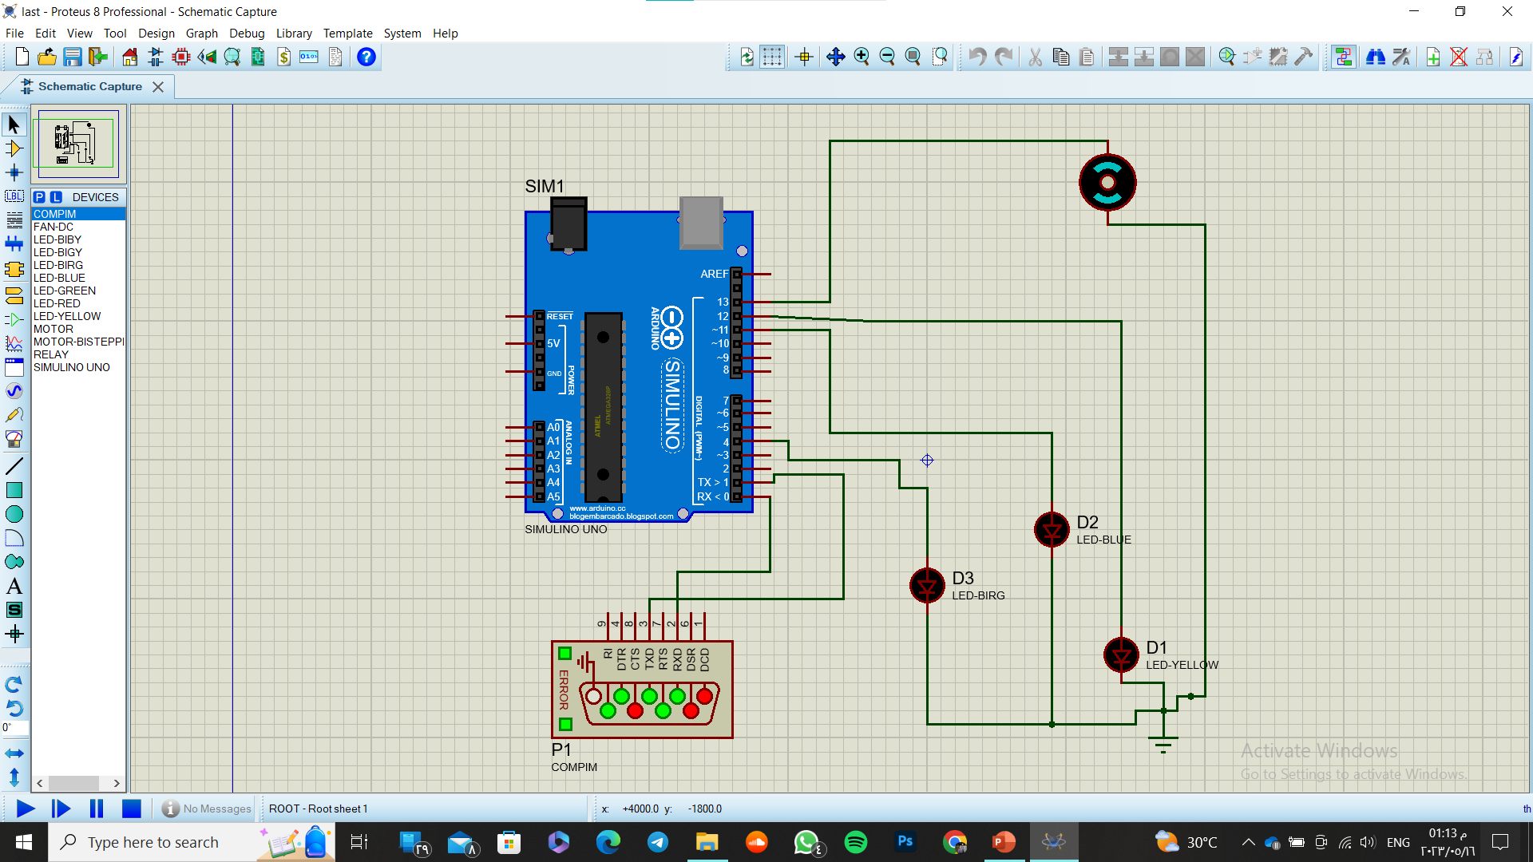

Slide 9
NAMES
1
Mahmoud Kordy Mostafa
2
Ahmed Mohamed Mahmoud
3
Ahmed Amin Mohamed

